Slide 1
An Introduction to Abstract Interpretation
2022-11-18

Slide 2
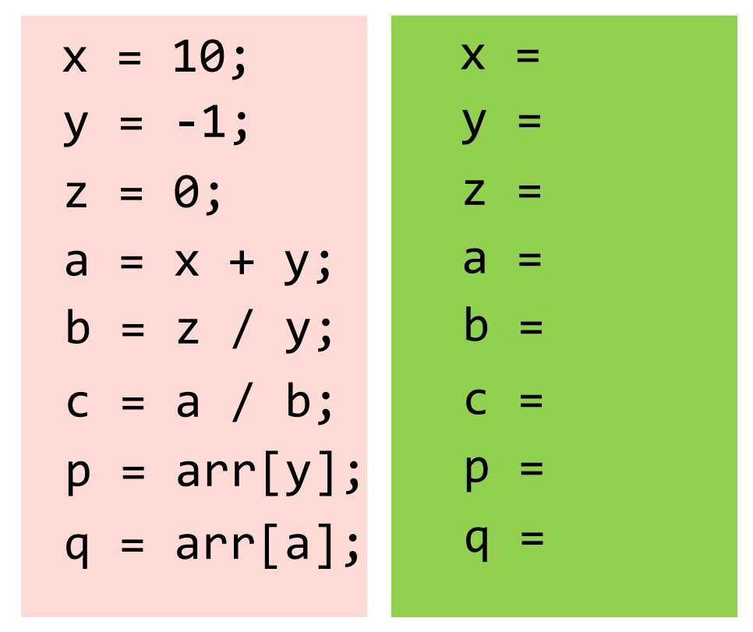
Abstract Interpretation – An Example
Given a target program, determine the sign (+/-/0) property of each variable of the program.
Motivation
Divided by zero (to find whether the denominator is zero)
Negative array indices (to find whether the index variable is negative)
……

Slide 3
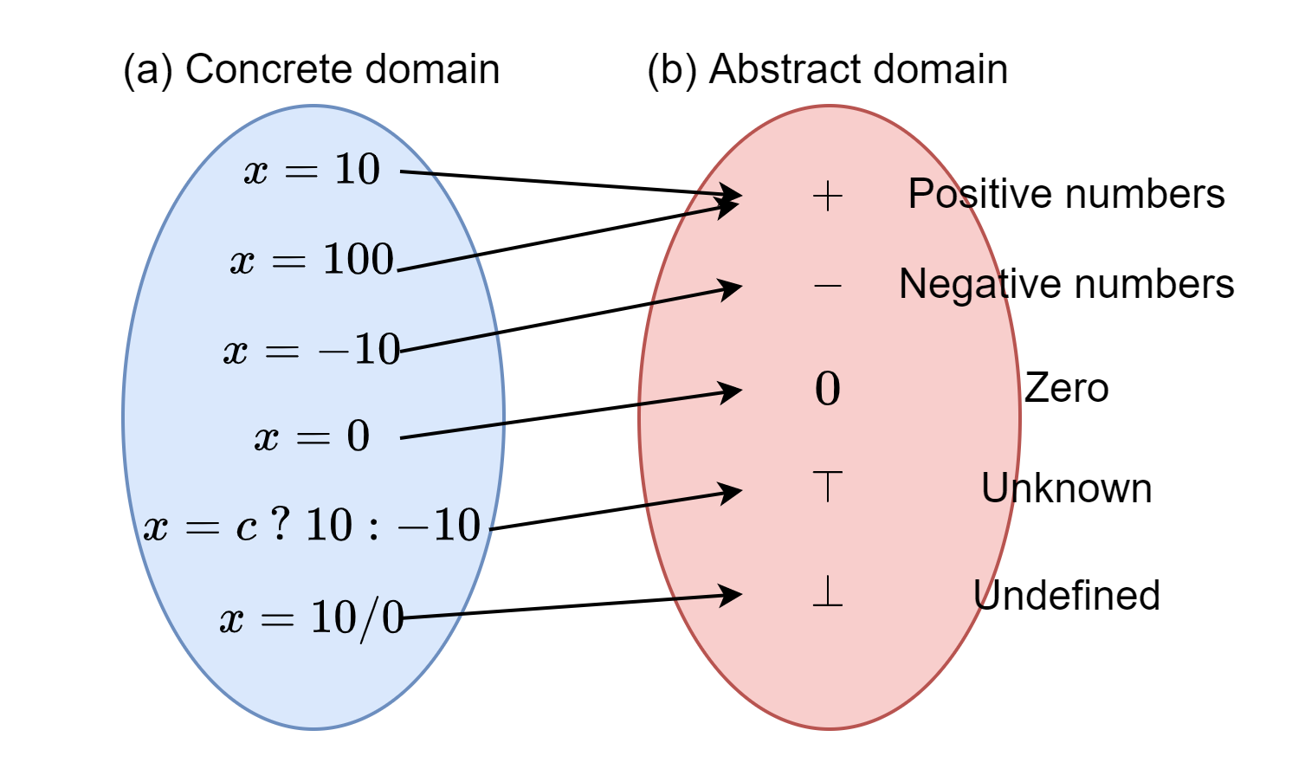
Abstraction

Slide 4
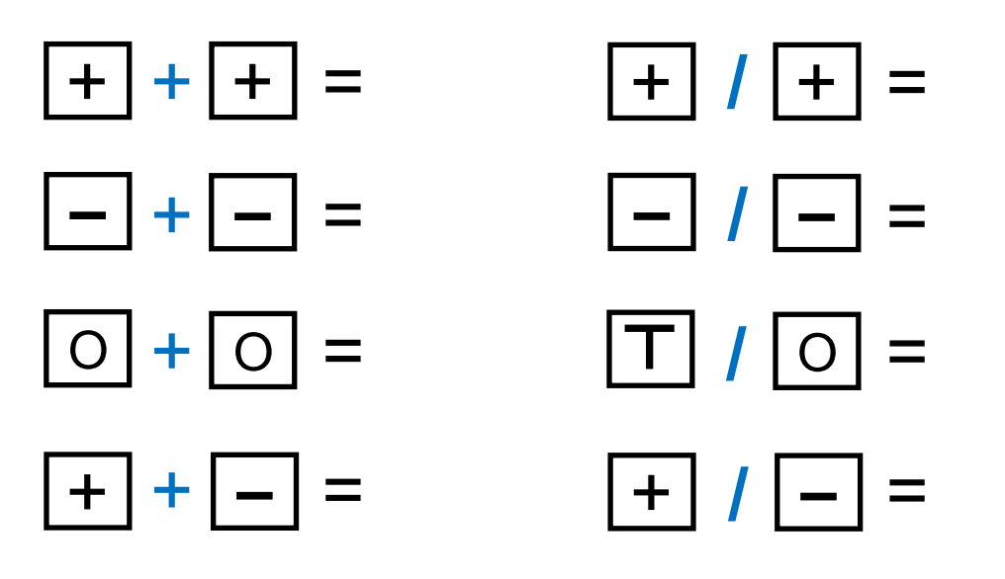
Abstract Operator

Slide 5
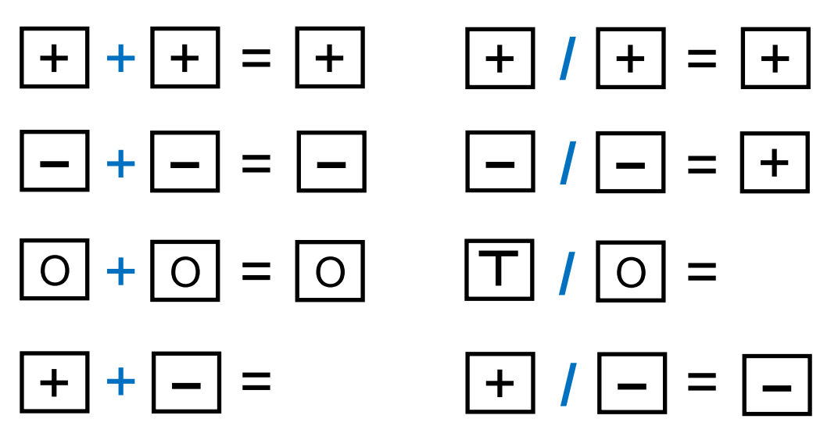
Abstract Operator

Slide 6
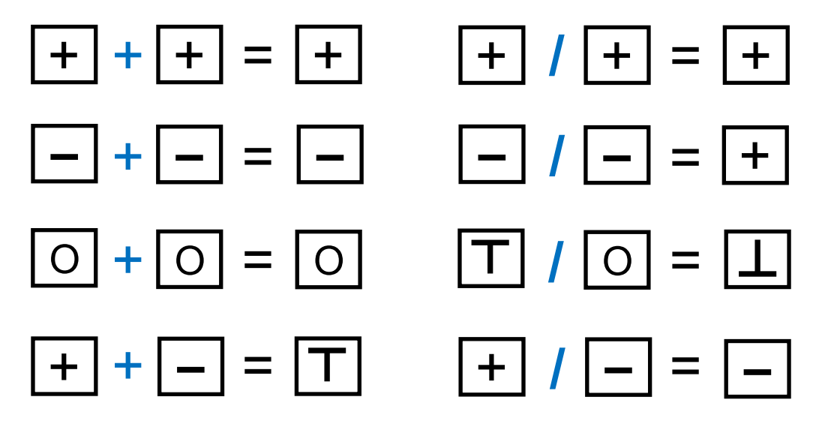
Abstract Operator

Slide 7
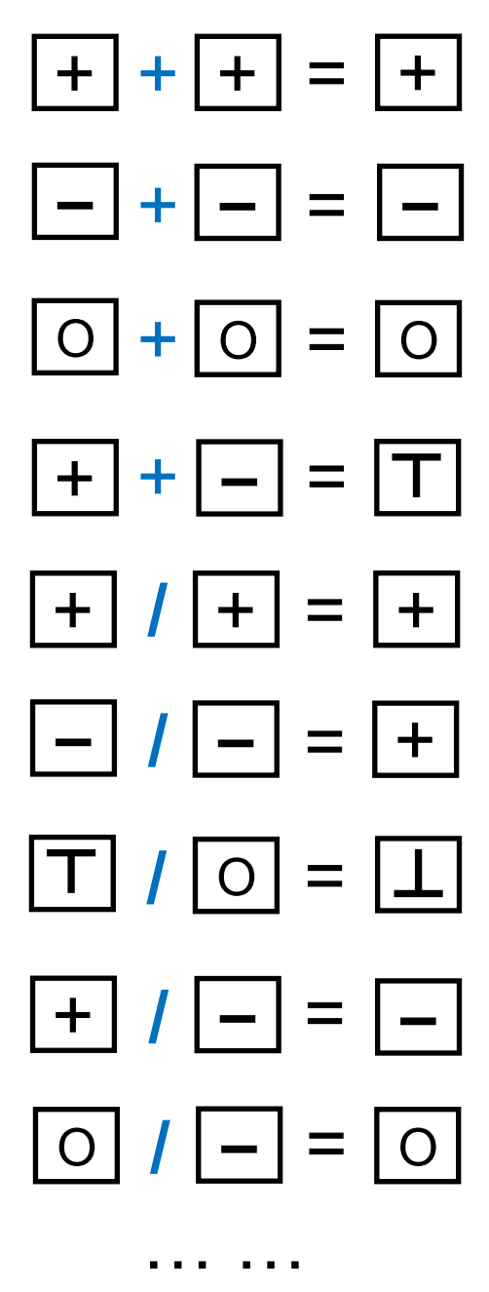
Abstract Operator

Slide 8
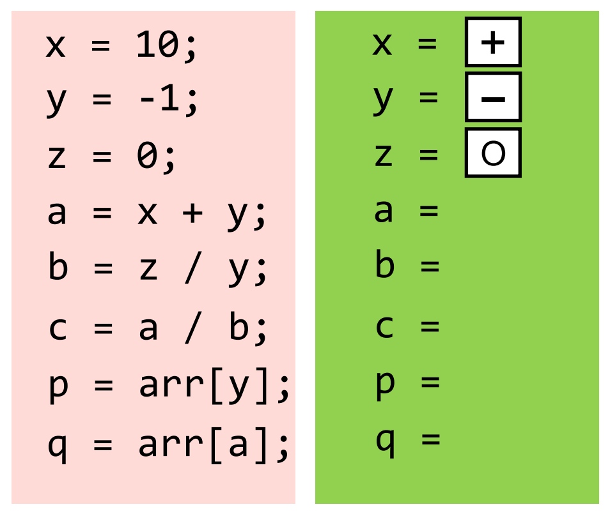
Abstract Operator

Slide 9
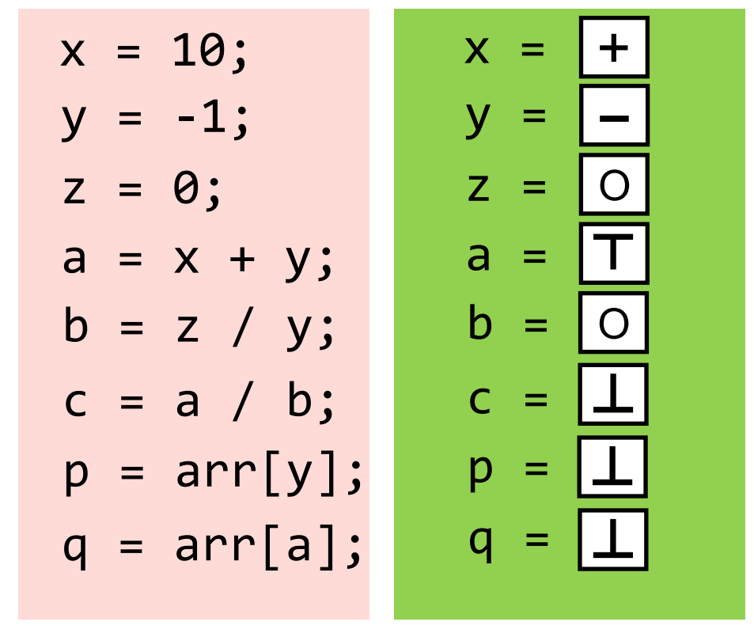
Abstract Operator

Slide 10
Abstract Operator

Slide 11
Abstract Operator

Slide 12
Abstract Operator

Slide 13
Abstract Operator
If we say there are no bugs, there are actually no bugs.

Slide 14
Abstract Interpretation
Abstract interpretation is a general static analysis framework that provides a sound approximation to the program semantics.
It promises to terminate in a fixed point with an abstraction of all the possible runtime states.
The key of its technique lies in abstracting a potentially infinite number of concrete execution states into a finite number of abstract states.

Slide 15


Concrete and Abstract Domains
$𝕊$ : the set of concrete values that a program variable can have (e.g., integers, floats and strings) in any possible concrete execution.
Concrete domain: powerset of $𝕊$: $ℂ=𝒫\left(𝕊\right)$.
The abstract domain $𝔸$ is an over-approximate abstraction of $ℂ$with a concretization function $γ∈𝔸→ℂ$based on a partial order $⊑$ over $𝔸$ such that ∀𝑎1, 𝑎2 ∈ $𝔸$, 𝑎1 ⊑ 𝑎2 ⇔ 𝛾(𝑎1) ⊆ 𝛾(𝑎2). The partial order relations of an abstract domain $𝔸$ form a lattice 𝔄 = ⟨$𝔸$, ⊑, ⊓, ⊔,⊥,⊤⟩.

Slide 16
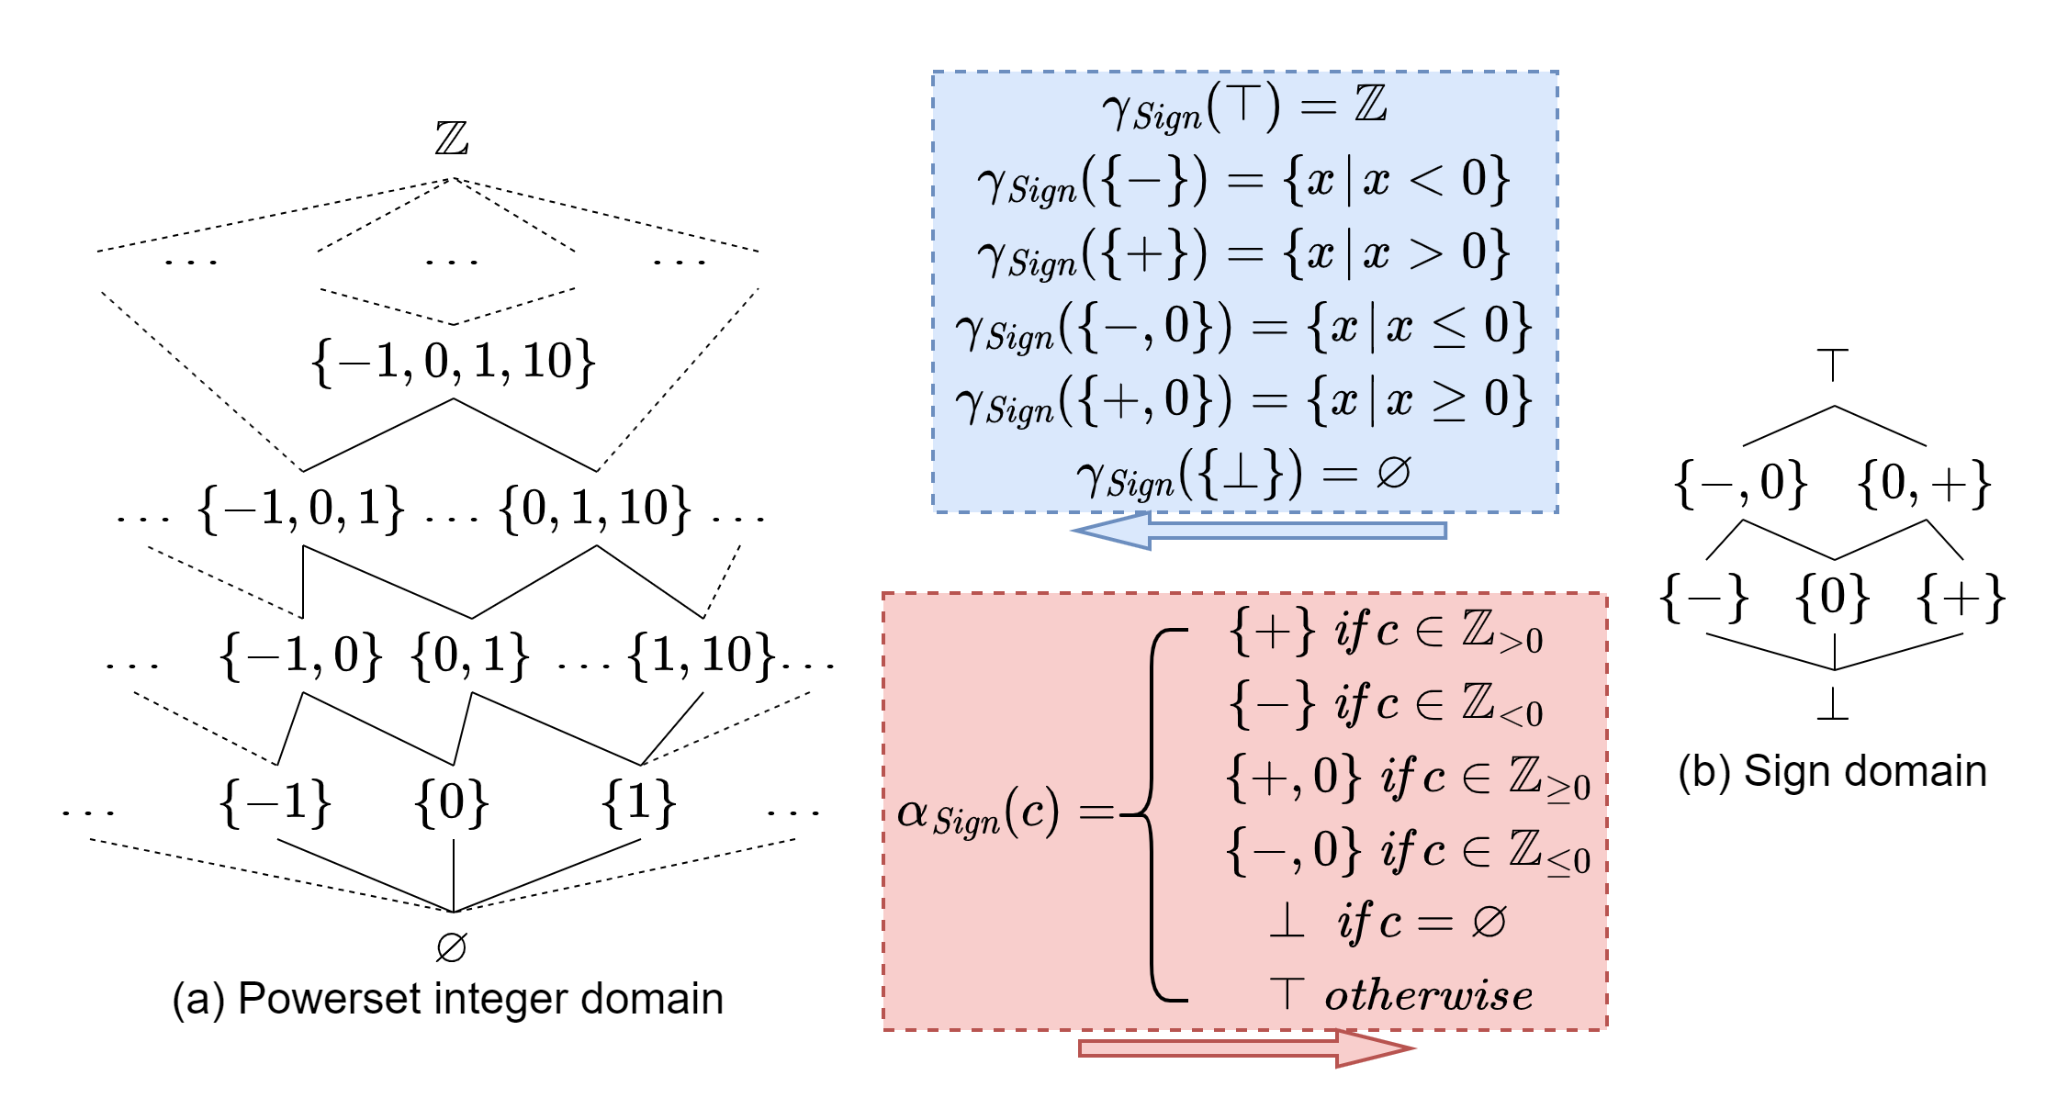
Concrete and Abstract Domains – An Example

Slide 17

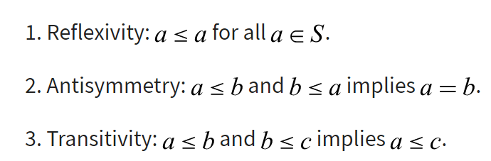
Concrete and Abstract Domains – An Example

Slide 18
Concrete and Abstract Domains – An Example

Slide 19
Concrete and Abstract Domains – An Example

Slide 20

Concrete and Abstract Domains – An Example
𝔄 = ⟨$𝔸$, ⊑, ⊓, ⊔,⊥,⊤⟩

Slide 21
Concrete and Abstract Domains – An Example

Slide 22
Concrete and Abstract Domains – An Example

Slide 23

Best Abstraction – Galois Connection
Galois Connection expresses a two-way connections between 𝔄 and ℭ using (1) an abstraction function 𝛼 : $ℂ$ → $𝔸$ mapping a set of concrete values to its abstract interpretation, and (2) a concretization function 𝛾 : $𝔸$ → $ℂ$ mapping a set of abstract values to concrete ones.
Intuitively, 𝛼 stresses on precision, aiming to obtain the best abstraction of concrete values, while 𝛾 emphasizes on soundness of the abstraction, making sure the approximation is conservative.

Slide 24
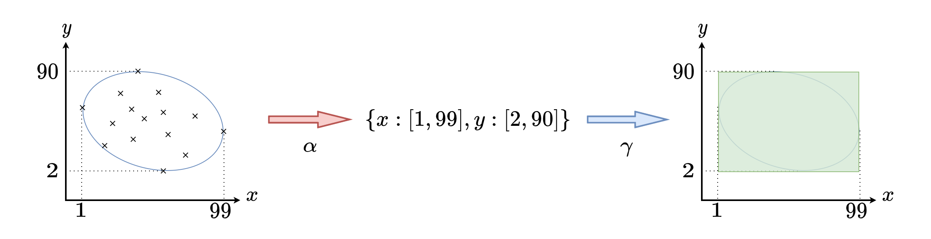
Interval Abstraction 𝛼 and Concretization 𝛾
Notes:
Figure 8.1 depicts an example from [12] to illustrate a interval concretization the abstraction functions using values on a two-dimensional coordinate. There are the 15 concrete coordinate points (in an oval area). These concrete points when projected on x-axis can be abstracted into an interval 𝑥 : [1, 99] via 𝛼. Similarly, the concrete value set projected on y-axis can be abstracted to 𝑦 : [2, 90]. Hence, we have an over-approximated rectangular area {𝑥 : [1, 99], 𝑦 : [2, 90]} representing the abstraction of the concrete values. Note that we assume the abstraction works on a non-relational domain (i.e., values of 𝑥 and 𝑦 are independent of each other).
Inversely, the concretization function can concreteize the abstract value {𝑥 : [1, 99], 𝑦 : [2, 90]} to yield all possible coordinates in the rectangular area, a super set of the original oval area.

Slide 25
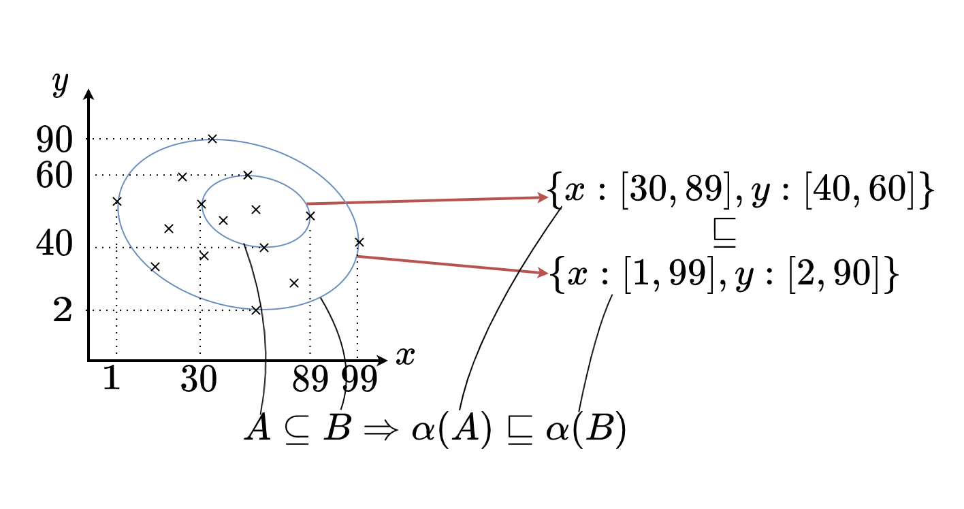
𝛼 is Monotone

Slide 26
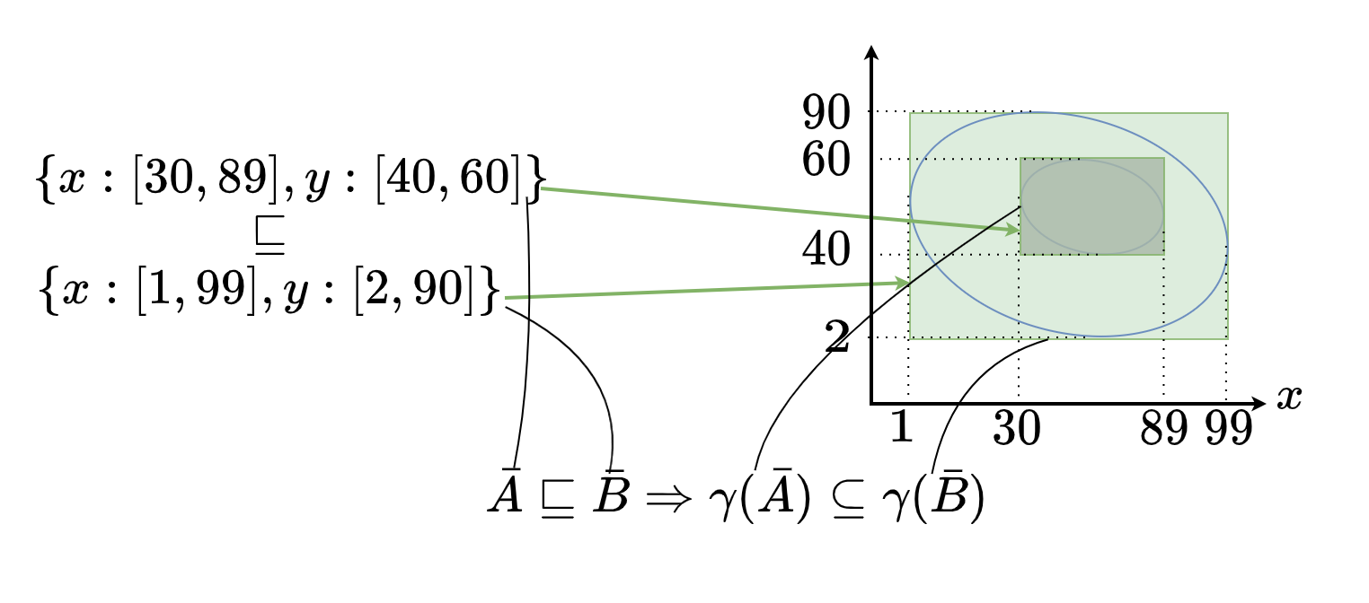
𝛾 is Monotone

Slide 27
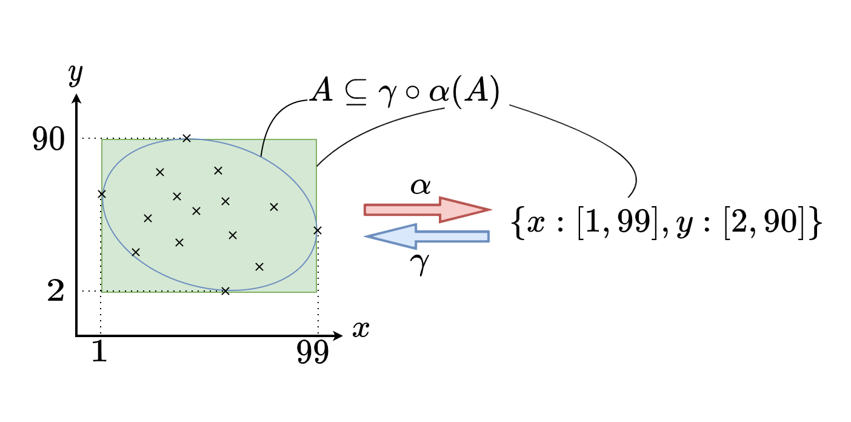
The 𝛾 ◦ 𝛼 Composition is Extensive
Notes:
We first abstract the 15 concrete coordinate points 𝐴 to its abstract
interpretation 𝛼(𝐴) = {𝑥 : [1, 99], 𝑦 : [2, 90]}, and then concretize the abstraction
back to the concrete values via 𝛾 ◦ 𝛼(𝐴), which yields all the coordinates in the
rectangular area. It is clear that the rectangular area is an over-approximation of the
original oval one with some precision loss by 𝛼. Hence the 𝛾 ◦ 𝛼 composition is
extensive (sound) such that ∀𝑐 ∈ C, 𝑐 ⊆ 𝛾 ◦ 𝛼(𝑐) should hold.

Slide 28
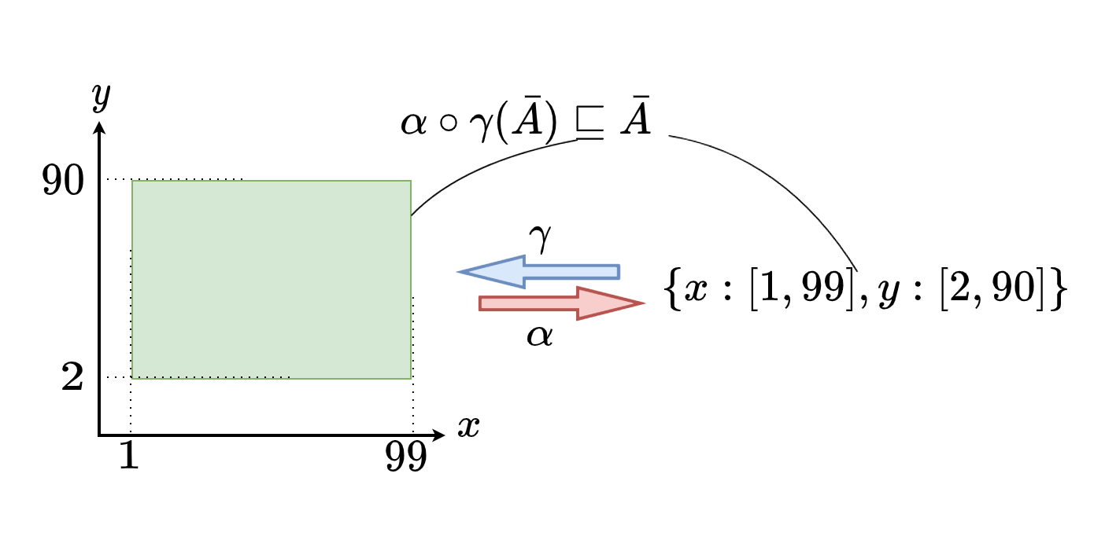
The 𝛼 ◦ 𝛾 Composition is Reductive
Notes:
We first concretize the abstract value ￣
𝐴
= {𝑥 : [1, 99], 𝑦 : [2, 90]}
to its concrete coordinates in the rectangular area and then abstract the concrete
values back to the abstract value via 𝛼 ◦ 𝛾( ￣
𝐴
), which produces the same abstraction
￣𝐴
represented by the original rectangular area. This means that the composition
function in this example 𝛼 ◦ 𝛾 does not lose precision (the best abstraction). The
𝛼 ◦ 𝛾 composition is reductive (precise) such that ∀𝑎 ∈ A, 𝛼 ◦ 𝛾(𝑎) ⊑ 𝑎 should hold

Slide 29
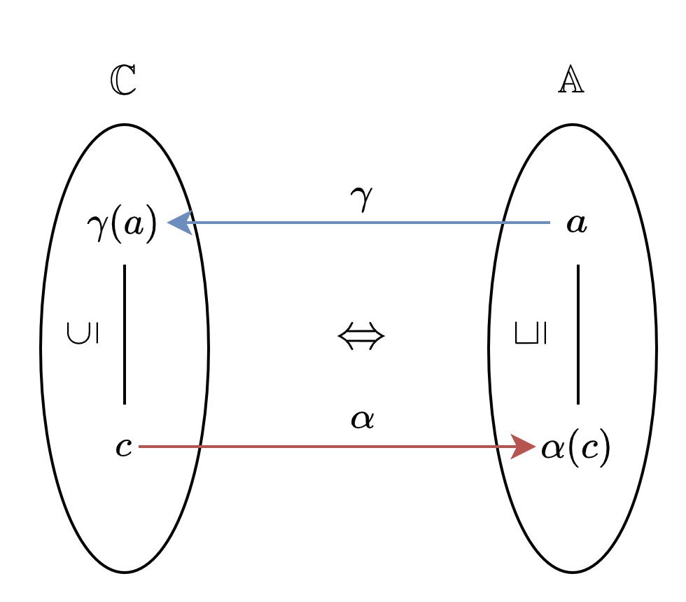
(𝛼, 𝛾) forms a Galois Connection
⇐ expresses soundness and ⇒ means best abstraction

Slide 30
Galois Connection - Sign Domain

Slide 31
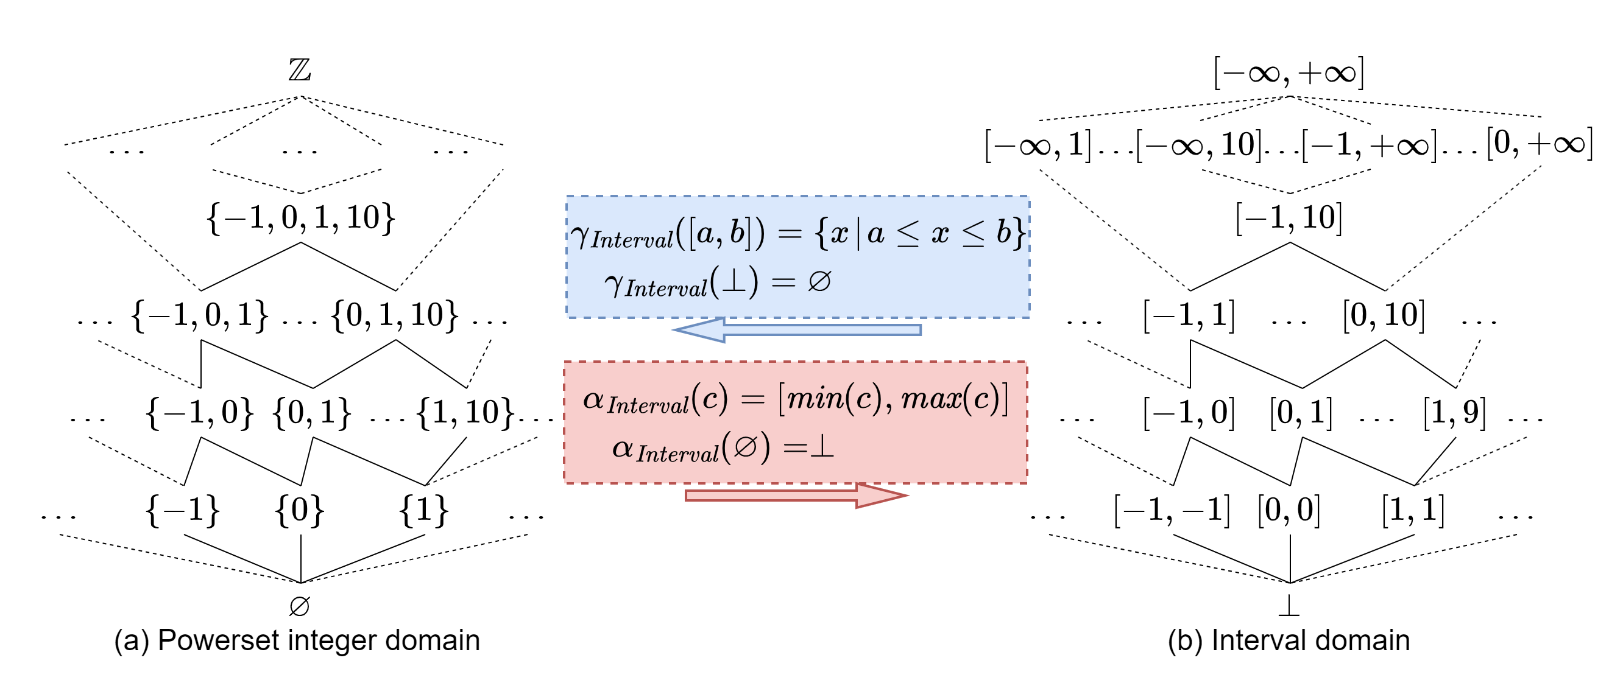
Galois Connection - Interval Domain

Slide 32

Best Operator Abstraction
Given a concretization function 𝛾 and a concrete operator 𝑓 ∈ ℂ → ℂ, the corresponding abstract operator 𝑓 ̂ ∈ 𝔸 →𝔸 should be a sound abstraction of 𝑓 such that ∀𝑎 ∈𝔸, 𝑓 (𝛾(𝑎)) ⊆ 𝛾(𝑓 ̂ (𝑎)) should hold.
In addition, the sound abstract operator𝑓 ̂ should also satisfy the property of best abstraction as implied by the reductive composition 𝛼 ◦ 𝛾.
The best operator abstraction with regard to 𝑓 can then be defined as$\hat{f}$= 𝛼 ◦ 𝑓 ◦ 𝛾.

Slide 33
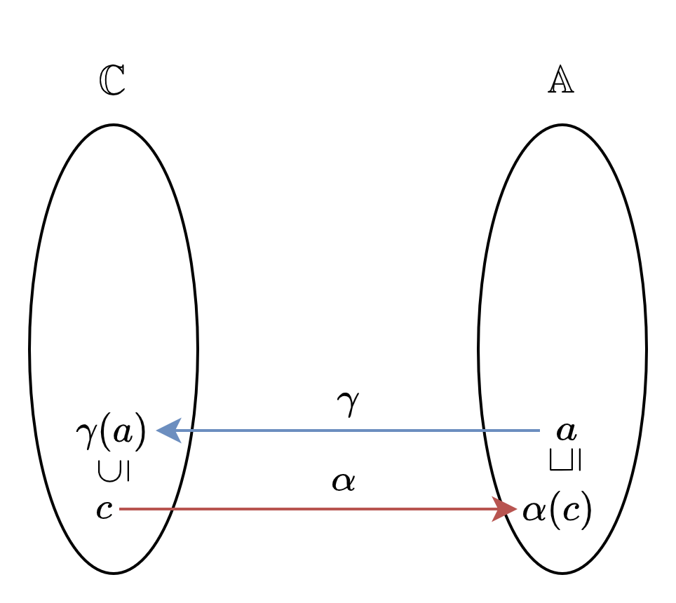
Best Operator Abstraction
⇐ expresses soundness and ⇒ means best abstraction

Slide 34
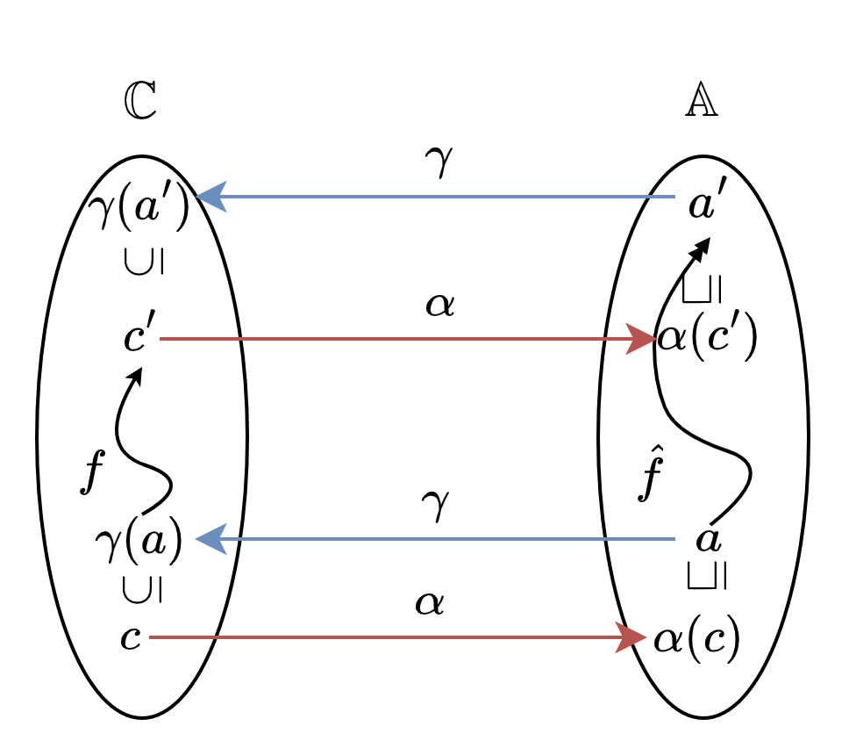
Best Operator Abstraction
⇐ expresses soundness and ⇒ means best abstraction
Notes:
Given the two operators ˆ 𝑓 and
𝑓 , we have 𝑎′ = ˆ 𝑓 (𝑎) denoting the abstract value transformed from 𝑎 via ˆ 𝑓 , and
𝑐′ = ( 𝑓 ◦ 𝛾) (𝑎) representing the concrete value transformed from 𝛾(𝑎) via 𝑓 .
Therefore, after substituting 𝑎′ = ˆ 𝑓 (𝑎) and 𝑐′ = ( 𝑓 ◦𝛾) (𝑎) into the Galois connection
𝑐′ ⊆ 𝛾(𝑎′) ⇔ 𝛼(𝑐′) ⊑ 𝑎′, we will have Equation 8.2.

Slide 35
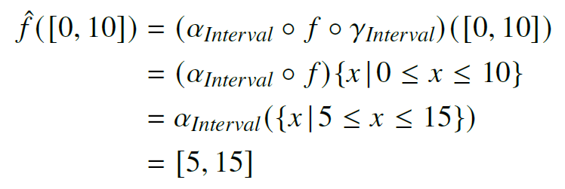

Best Operator Abstraction – Interval Domain
Let the concrete operator 𝑓 ∈ $ℂ$ → $ℂ$ be 𝑓 (c) = {𝑐 + 5 | 𝑐 ∈ $ℂ$}, e.g., 𝑓 ({0, 5, 10} = {5, 10, 15}. The best abstract operator on interval domain can be defined as $\hat{f}$= 𝛼 ◦$f$ ◦𝛾. We have 𝛼 ({0, 5, 10}) = [0, 10] and:

Slide 36
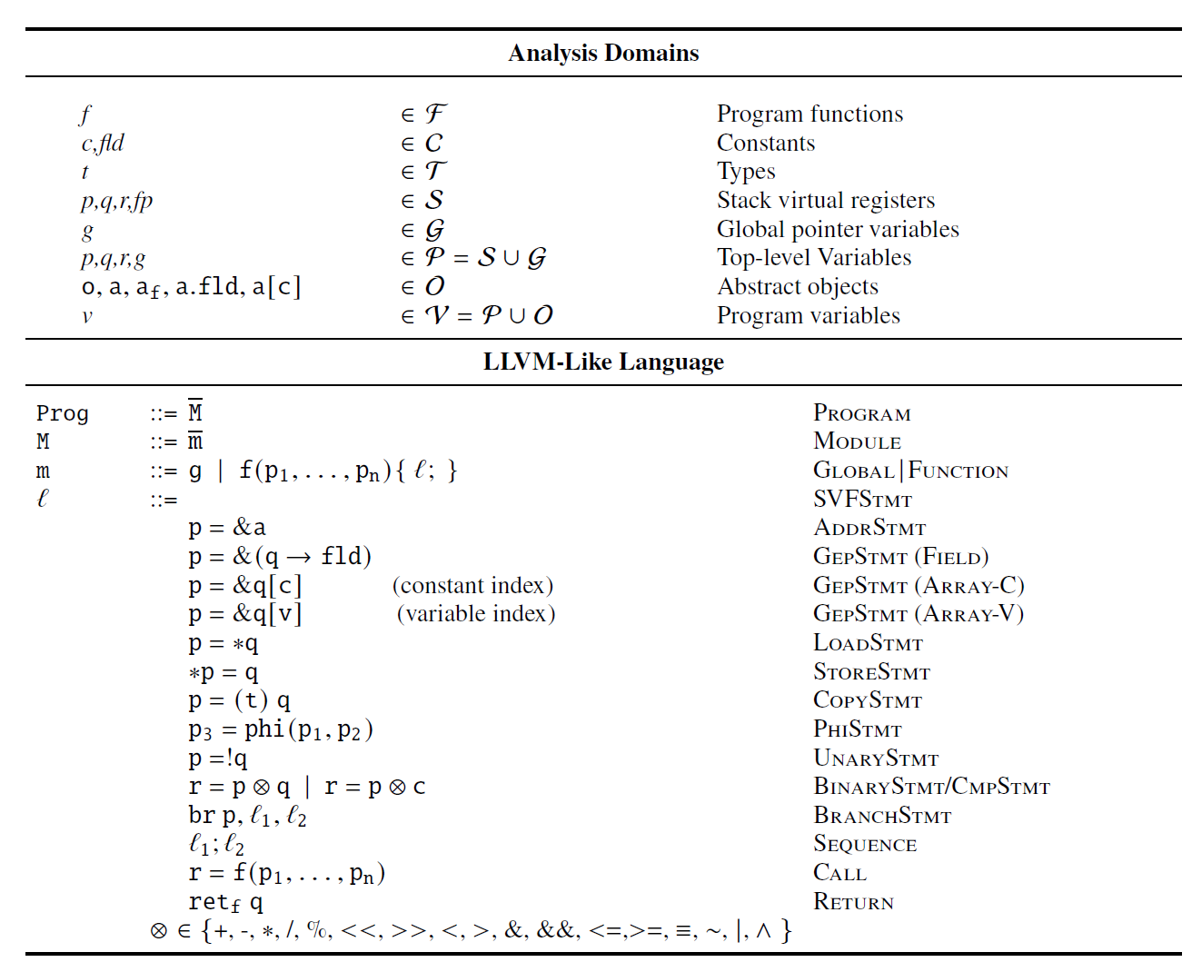
Analysis Domain and SVF IR

Slide 37

Abstract State (AS)
$[𝔸]$ :a collection of abstract domains
$AS=𝒱→⋃\left[𝔸\right]$
The Galois connection between concrete and abstract state is the point-wise lifting of the Galois connection between the corresponding concrete and abstract domain. We use the same notation for the operation on abstract state as on the abstract domain.
For example, the abstract state of 𝑐 = {𝑥 : 5, 𝑦 : −5} in terms of sign domain is 𝛼(𝑐) = {𝑥 : 𝛼(5) = {+}, 𝑦 : 𝛼 (−5) = {−}}.
Notes:
from program variables to the union of all possible abstract values from the collection of abstract domains.

Slide 38

Abstract Trace: a pair (𝛿, 𝜎)
𝛿 ∈ $𝒱$ → [$𝔸$] maps program variable 𝑥 to a chosen abstract domain 𝛿(𝑥) (e.g., Sign domain.
𝜎 ∈ $𝒱$×$ℒ$ → $⋃$[$𝔸$] returns 𝑥’s value at a particular program point/location 𝐿 ∈ $ℒ$ from the chosen domain (i.e., 𝜎(𝑥, 𝐿) ∈ 𝛿(𝑥)).
𝐿 can be a program point immediately before ($\overline{ℓ}$) or after ($\underline{ℓ}$) a program statement $ℓ$.
For example, if 𝛿(𝑥) = Interval, we may have 𝜎(𝑥, 𝐿) = [0, 5] but not 𝜎(𝑥, 𝐿) = +.

Slide 39
Abstract Execution
We can define the abstract execution as the process of deriving program semantics based on abstract trace (𝛿, 𝜎).
at most one abstract trace per program because it over-approximates all the feasible concrete traces of the program.
Abstract execution follows the control flow graph and updates (𝛿, 𝜎) according to the statement encountered.

Slide 40


Least Fixed Point
The abstract execution is characterized by the least fixed point of semantic function $\hat{F}$∈ 𝜎 → 𝜎 such that:
${\hat{f}}_{ℓ}$∈ AS → AS represents the monotone semantic transfer function at $ℓ$ according to ICFG and $X$ is the semantic collecting function.
The least fixed point of $\hat{f}$ is $lfp \hat{f}=⊓\{a∈AS,\hat{f}\left(a\right)⊑a\}$, which is the meet of a set of abstract states satisfying $\hat{f}\left(a\right)⊑a$.

Slide 41
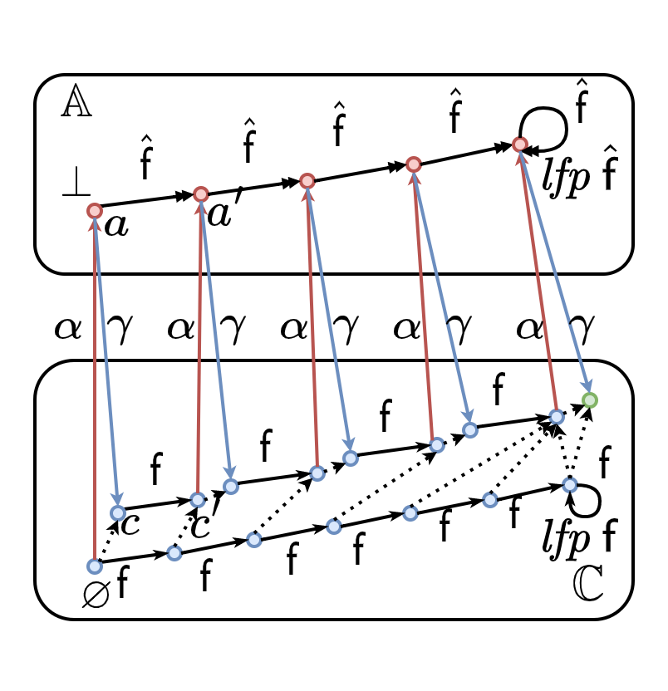
Least Fixed Point
Notes:
An abstract state 𝑎
(initialized with ⊥) is first concretized to its corresponding concrete state 𝑐 = 𝛾(𝑎),
which is then transformed to 𝑐′ via f. After this, 𝑐′ is abstracted back to the abstract
domain, to produce 𝑎′ = 𝛼(𝑐′), which is also the abstract state transformed from 𝑎
viaˆf, according toˆf = 𝛼 ◦ f ◦ 𝛾. After a number ofˆf iterations (5 in this example),
the abstract execution is terminated with a least fixed point lfpˆf, which is a sound
approximation of the fixed point in the concrete domain, i.e., lfp f ⊆ 𝛾(lfpˆf). Note
that, there are more f iterations (7 in our example) to reach the fixed point if we
concretely execute the program.

Slide 42
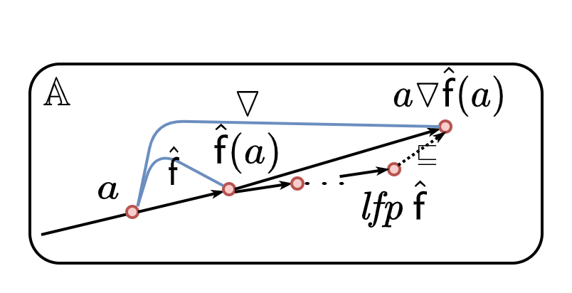
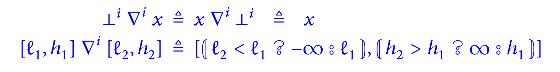

Widening
Let $a^{n}$ be the abstract value of 𝑥 in the $n^{th}$ iteration. The idea of the widening is to extrapolate from an iterate $a^{n}$ and the next iterate $a^{n+1}$ to an upper bound $a^{n}$ ▽ $a^{n+1}$ to accelerate or enforce the convergence of the iterates in finitely many steps.
Notes:
The abstract state 𝑎 is transformed
toˆf (𝑎) and is then widened to an upper bound 𝑎▽ˆf (𝑎), while it takes much more
iterations to reach the fixed point lpfˆf. The side-effect of widening is that it may loss
precision of the analysis, i.e., lpf ˆf ⊑ 𝑎▽ˆf(𝑎).

Slide 43
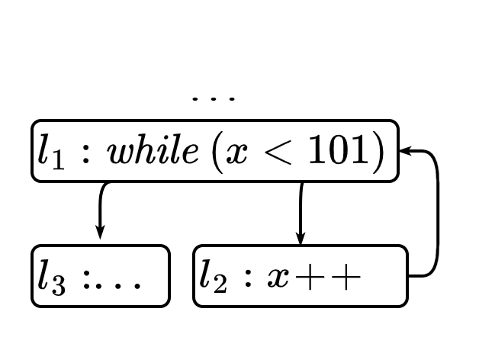
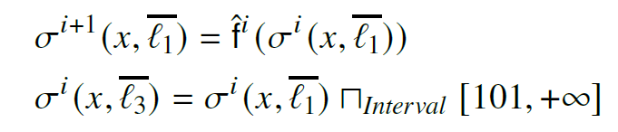
Widening – An example
Notes:
the fixpoint computation amounts to solving the fixpoint system of equations

Slide 44
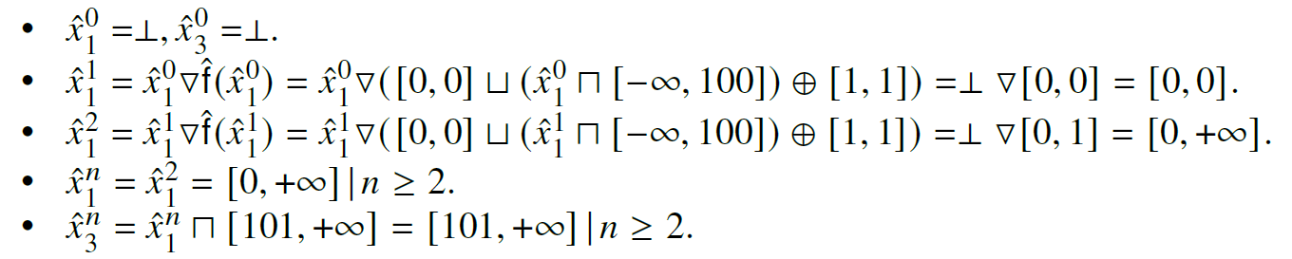
Widening – An example

Slide 45
Widening – An example

Slide 46
Widening – An example

Slide 47
Widening – An example

Slide 48
Widening – An example

Slide 49


Widening – An example

Slide 50
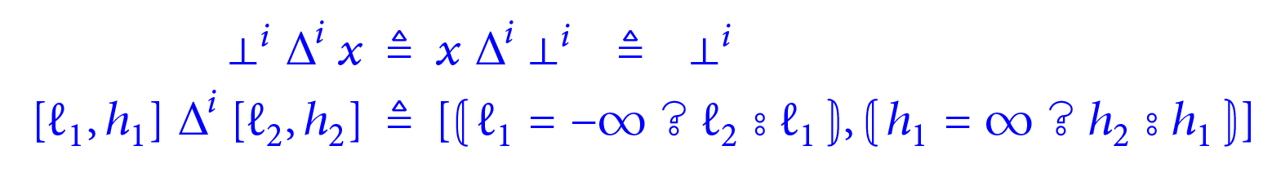
Narrowing
Narrowing aims to refine the infinite upper bound to a more precise result.

Slide 51
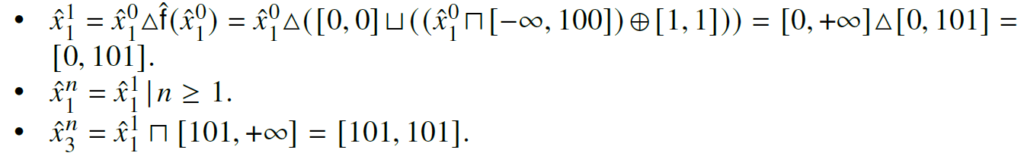
Narrowing

Slide 52
Narrowing

Slide 53
Narrowing

Slide 54
Abstract Execution over Multiple Domains
Using an unitary abstract domain to derive abstract trace at each program location may not be able to precisely cover all program semantics.

Slide 55
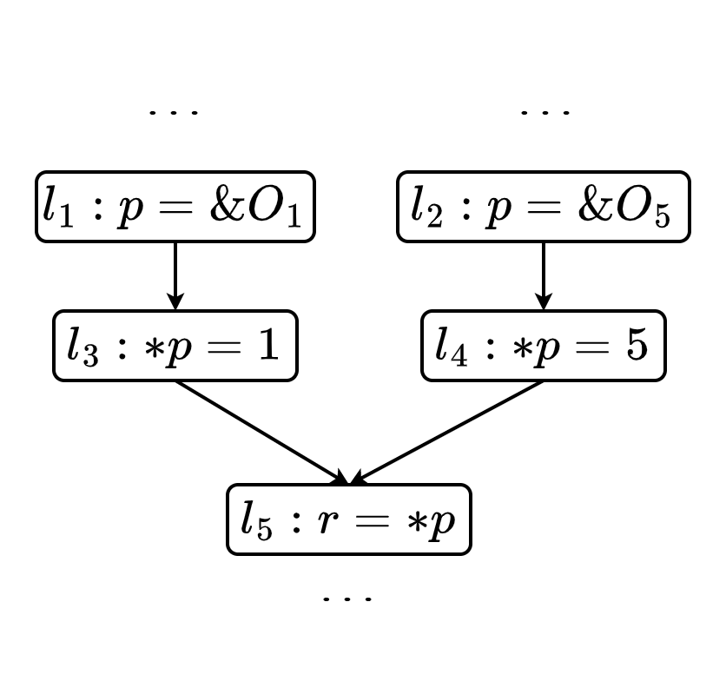
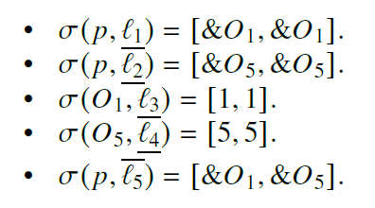
Abstract Execution over Multiple Domains

Slide 56
Abstract Execution over Multiple Domains

Slide 57
Abstract Execution over Multiple Domains

Slide 58
Abstract Execution over Multiple Domains

Slide 59
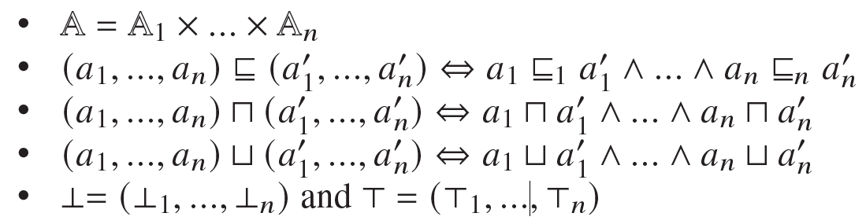

Cartesian Product
Given 𝑛 > 1 abstract domains $⟨𝔸_{i} , ⊑_{i} , ⊓_{i} , ⊔_{i} ,⊥_{i} ,⊤_{i}⟩,$the combined domain $⟨A, ⊑, ⊓, ⊔,⊥,⊤⟩$should have the following properties:

Slide 60
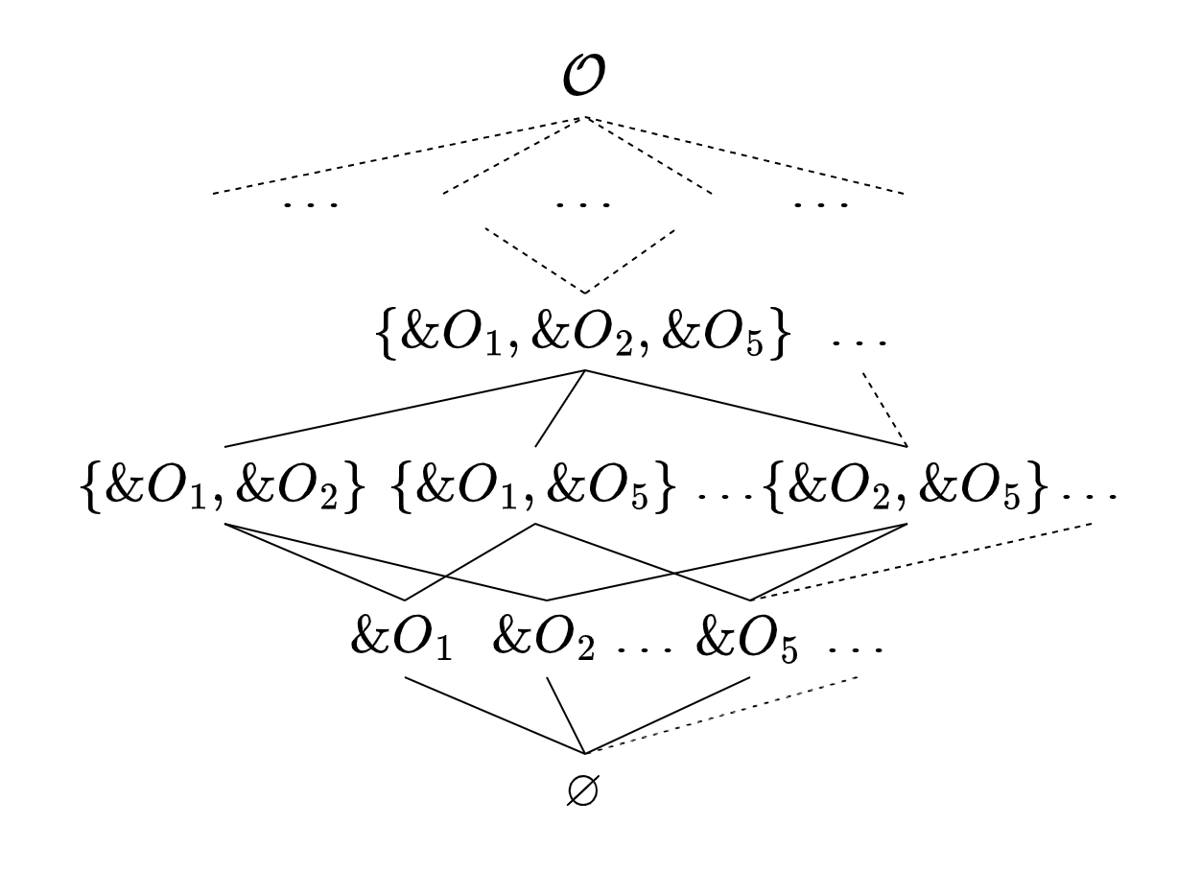
Allocation-Site Powerset Domain

Slide 61
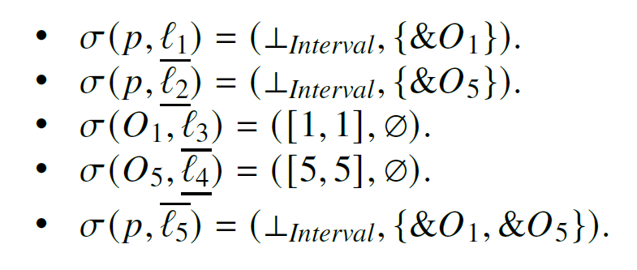
Allocation-Site Powerset Domain

Slide 62
Allocation-Site Powerset Domain

Slide 63
Allocation-Site Powerset Domain

